Slide 1

ANTROPOMETRY, BODY COMPOSITION AND BIOIMPEDENTIOMETRY
Prof. Luigi SCHIAVO, PhD, FACN
Associate Professor of Human Nutrition and Applied Dietetics
Department of Medicine, Surgery and Dentistry
University of Salerno, Italy
Regional Delegate (Campania, Italy) of Bariatric Nutrition
Italian Society of Obesity Surgery and Metabolic Disease (SICOB)

Slide 2
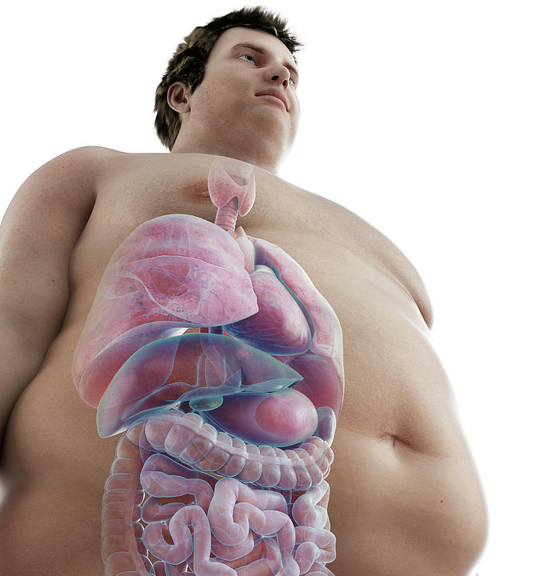

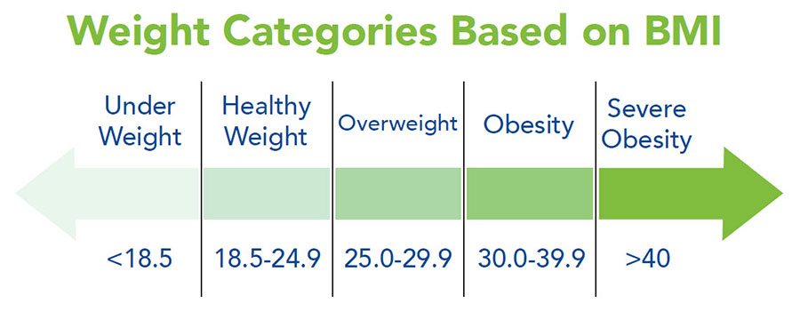
CLINICAL OBESITY is a chronic systemic disease that can affect one or more organs indipendently of other diseases
CLINICAL OBESITY is a SPECTRUM
From a clinical point of view
means different things in different individuals
Doesn’t tell us if somebody have
ILLNESS
RISK OF ILLNESS

Slide 3
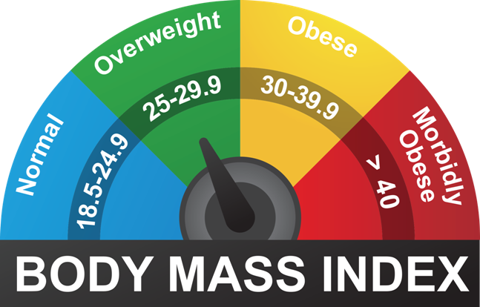
Until today we were using classification of obesity based on BMI that doesn’t distinguish among those different situations
Doesn’t distinguish among
ILLNESS
RISK OF ILLNESS
From a clinical point of view
A CLASSIFICATION IS NOT A CLINICAL DIAGNOSIS
CLINICAL DIAGNOSIS is crucial to make the correct clinical decision

Slide 4

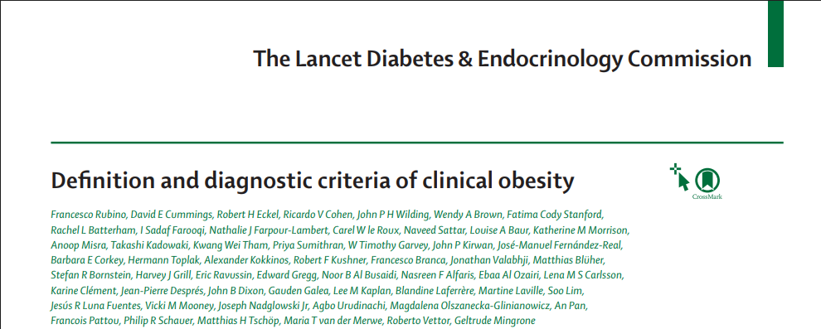
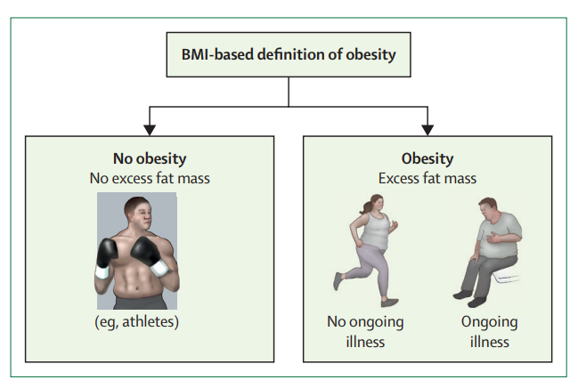
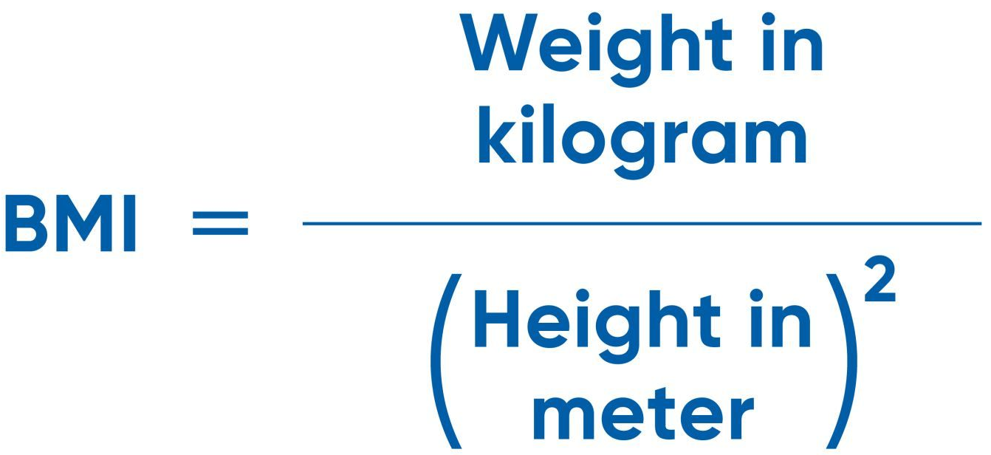
BMI it is only a mathematical formula on weight and height and do not give any informations about whether the excess weight comes from excess fat tissue or increased lean mass
BMI do not give any informations about whether your hearth, liver, kidney, or lungs are working as they should or not
BMI it is not a clinical informations and cannot be used for clinical diagnosis

Slide 5
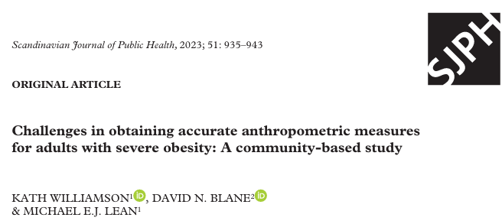
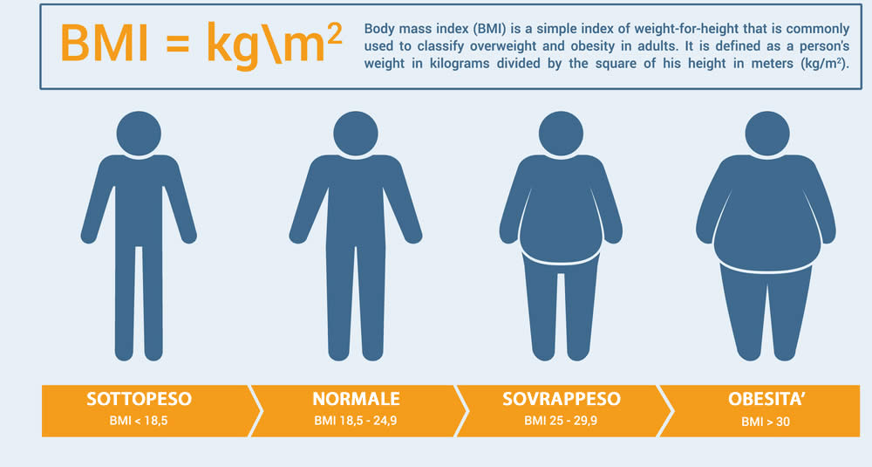


Failure to measure weight and height accurately can exclude people from appropriate care
Weight = 116 kg
Height= 1.70 cm
BMI = 40.1 kg/m²
Weight = 115 kg
Height= 1.71 cm
BMI = 39.3 kg/m²
Eligible for Metabolic and Bariatric Surgery
Not Eligible for Metabolic and Bariatric Surgery
One practical consequence is that approximately 30–40% of people in some countries would be diagnosed as having obesity and would be rendered eligible for expensive (and potentially unnecessary) treatments, and viceversa

Slide 6
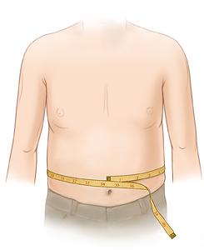
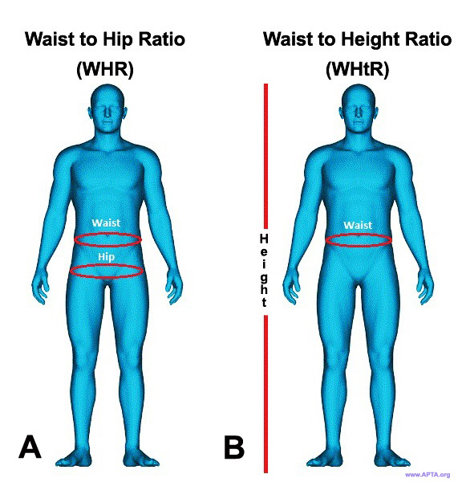
Other anthropometric measures of adiposity
Other anthropometric measures, such as waist circumference, waist-to-hip ratio, and weight-to-height ratio have been suggested as alternative methods to BMI for diagnosis of obesity.
However, these anthropometric measures also have notable limitations.
Waist Circumference
Waist-to-hip ratio (WHR)
Weight-to-height ratio (WtHR)
Measurements of waist circumference and waist-to-hip ratio can vary across populations and between sexes.
These measurements might not accurately reflect subcutaneous and visceral fat accumulation, which is closely associated with an increased risk of metabolic diseases.
Also, persons matched for visceral adiposity can show differences in their risk-factor profile.
Other ectopic fat depots, including liver fat, also contribute to variations in health risk.

Slide 7
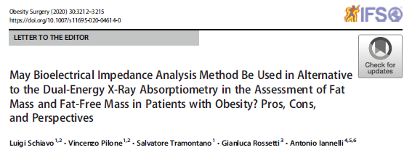
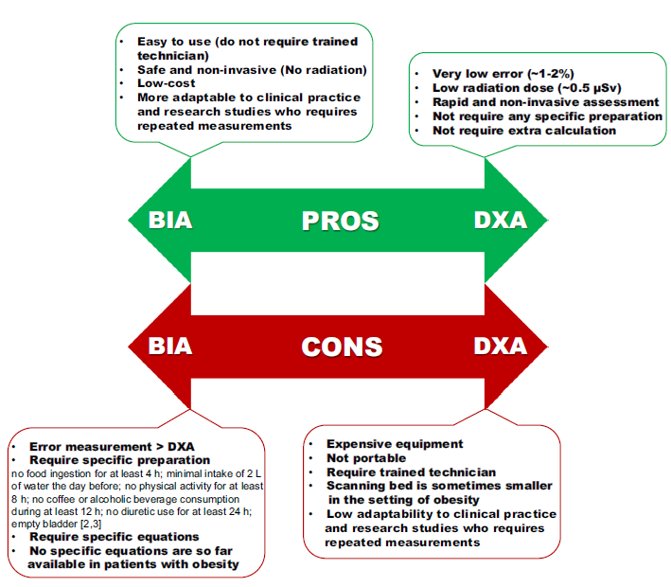
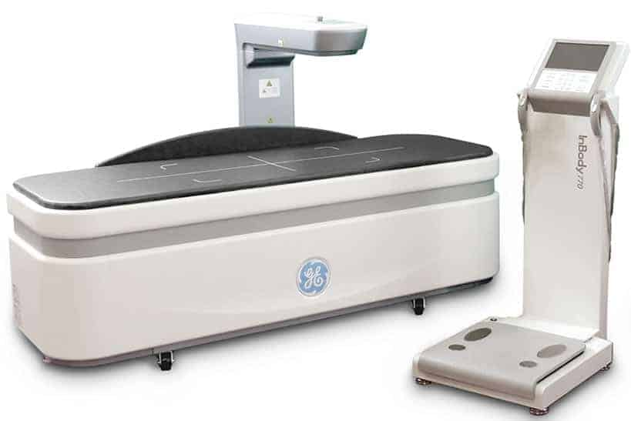
DEXA = GOLD STANDARD
BIA = ALTERNATIVE METHOD

Slide 8
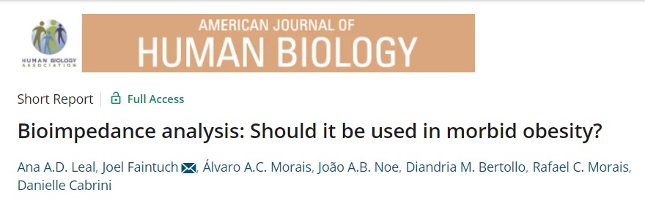
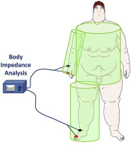
23:420–422 (2011)
Many predictive equations associated with the BIA measurements are inadequate because they have been developed in normal-weight subjects.
In patients with obesity BIA is associated with an:
overestimation of FFM
underestimation of FM
BIA
Validation and comparative studies of FM and FFM assessment by BIA and DEXA in patients with different obesity grades have shown controversial results

Slide 9
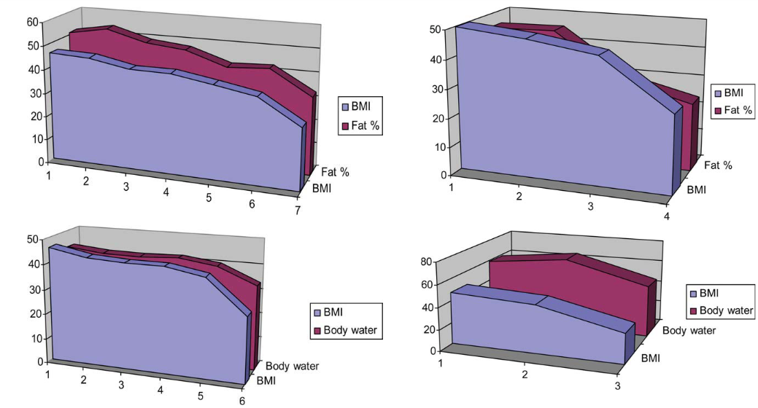
Bariatric candidates (n = 94), (68.1% females)
Age was 34.9 ± 10.4 years
BMI was 40.8 ± 4.6 kg m²
23:420–422 (2011)
Body Fat and water were entirely compatible with the expected BMI range for women.
In males, fat percentage was underestimated and water overestimated

Slide 10
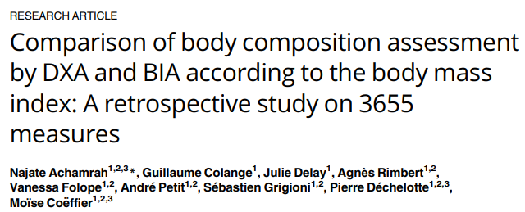
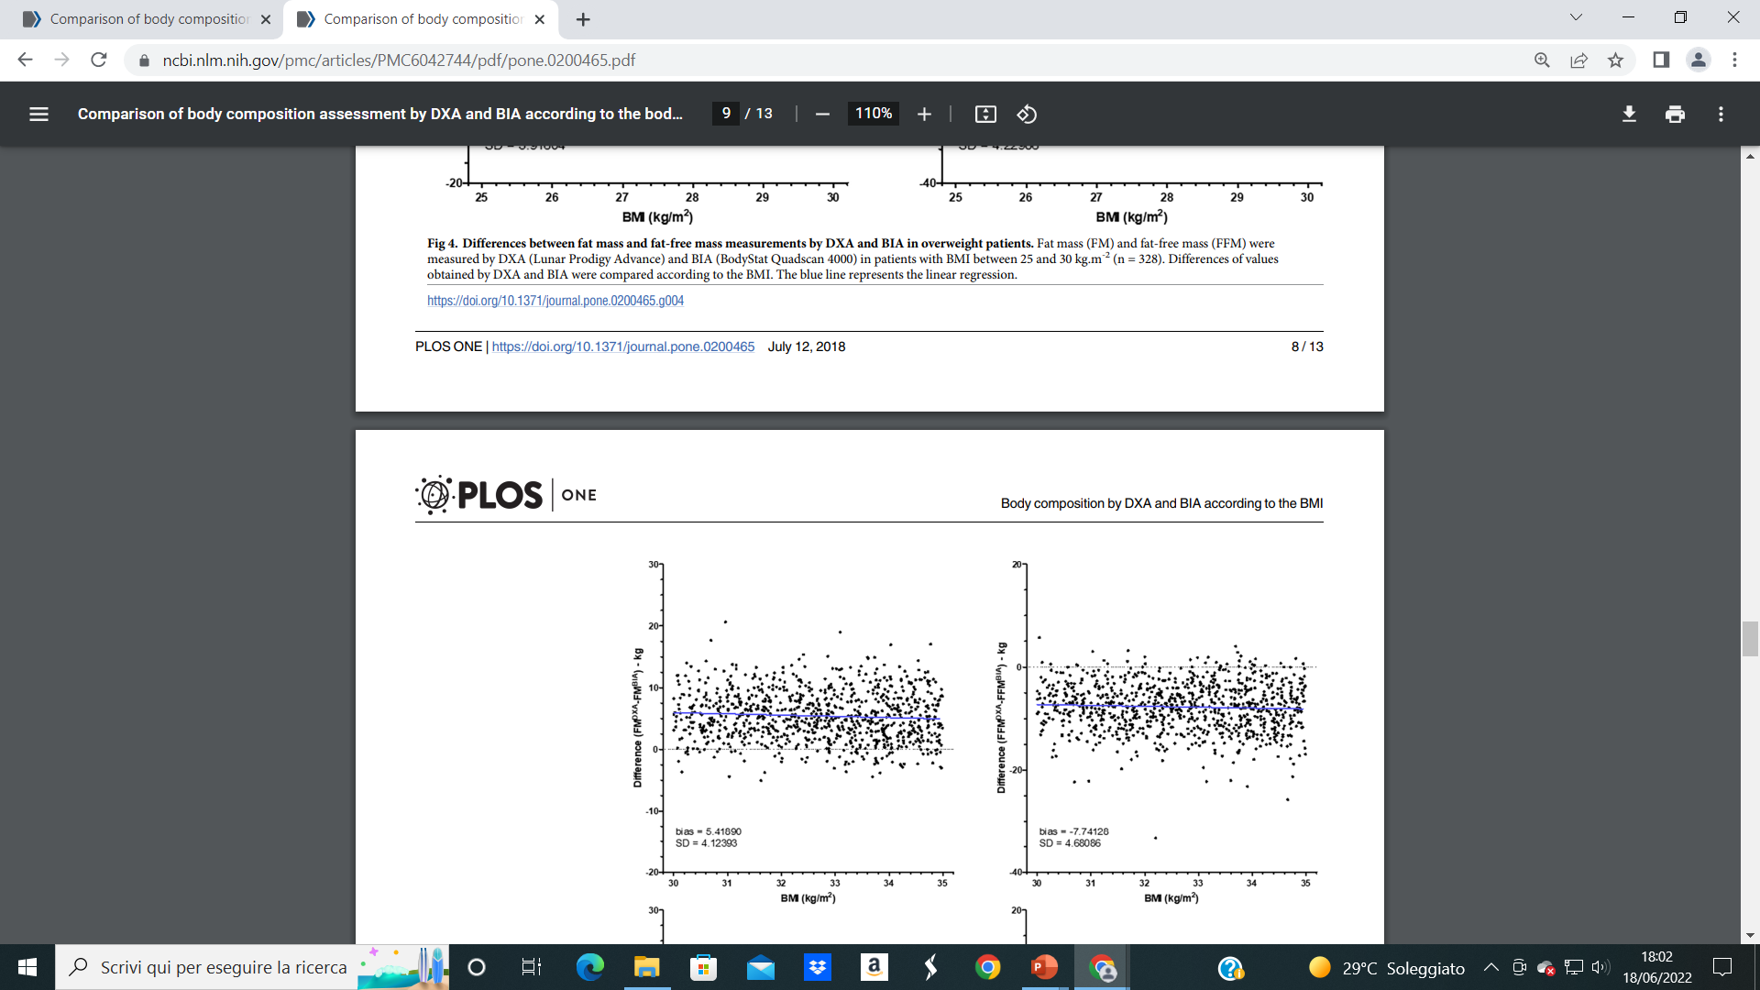
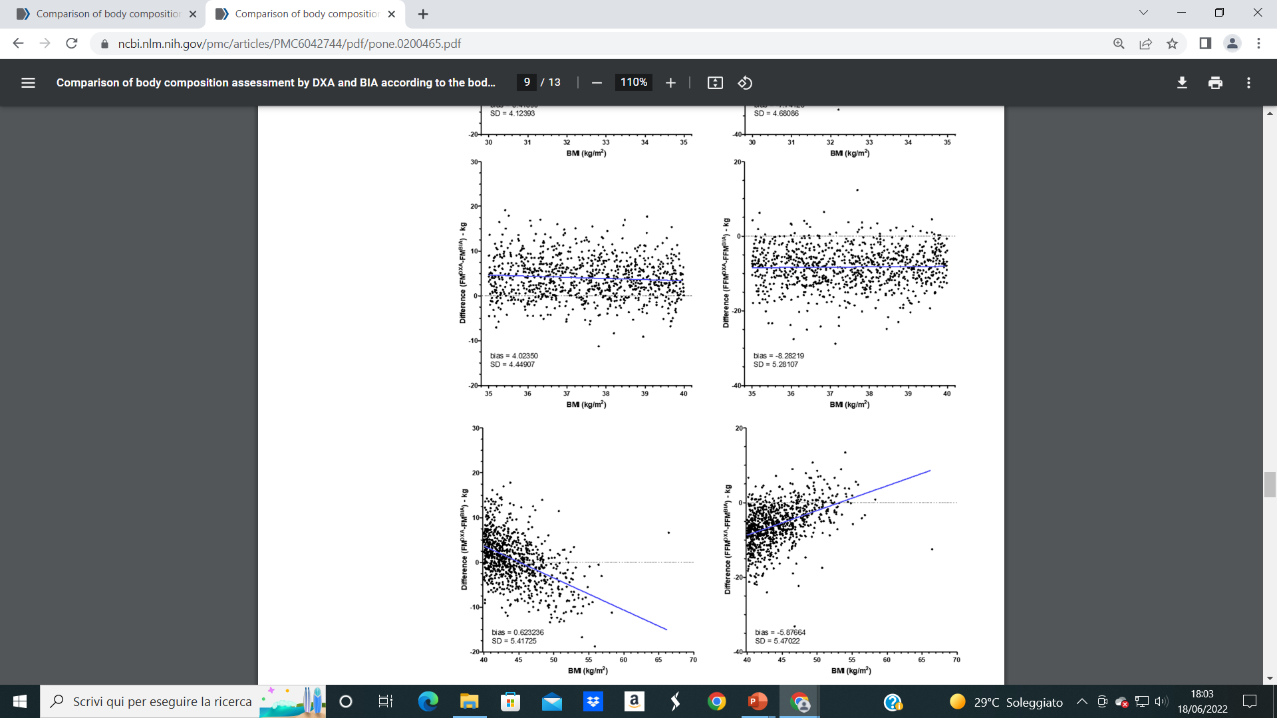
PLOS ONE: https://doi.org/10.1371/journal.pone.0200465 July 12, 2018
In patients with obesity,
BIA underestimated FM (ΔFM [kg] = 5.4 ± 0.1) and overestimated FFM (ΔFFM [kg] = − 7.7 ± 0.1) compared with DEXA method

Slide 11
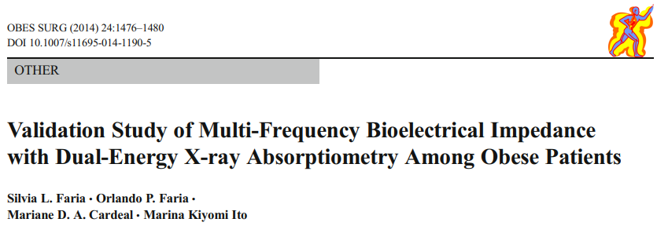
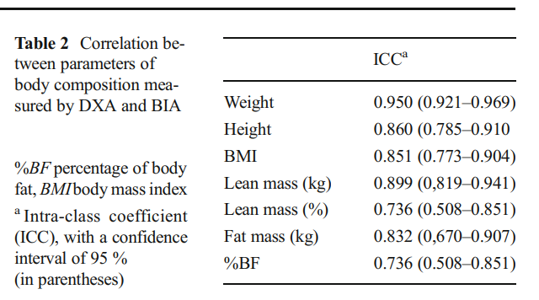
Cross-sectional validation study
73 patients with obesity invited to undergo a multi-frequency BIA and afterwards a DEXA examination
Main Findings:
an almost perfect correlation of FM and FFM (ICC = 0.832 and ICC = 0.899, respectively)
ICC= intraclass correlation coefficient

Slide 12
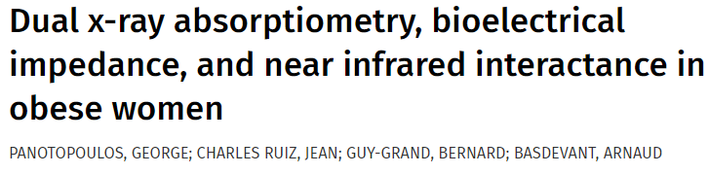
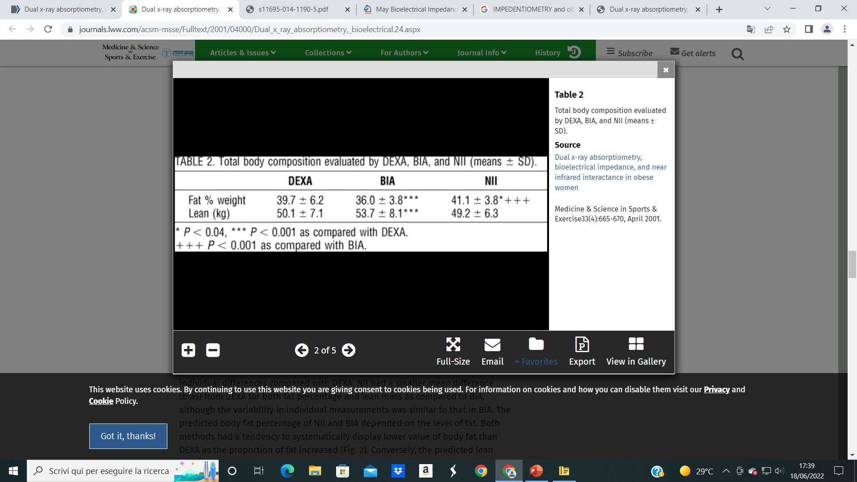
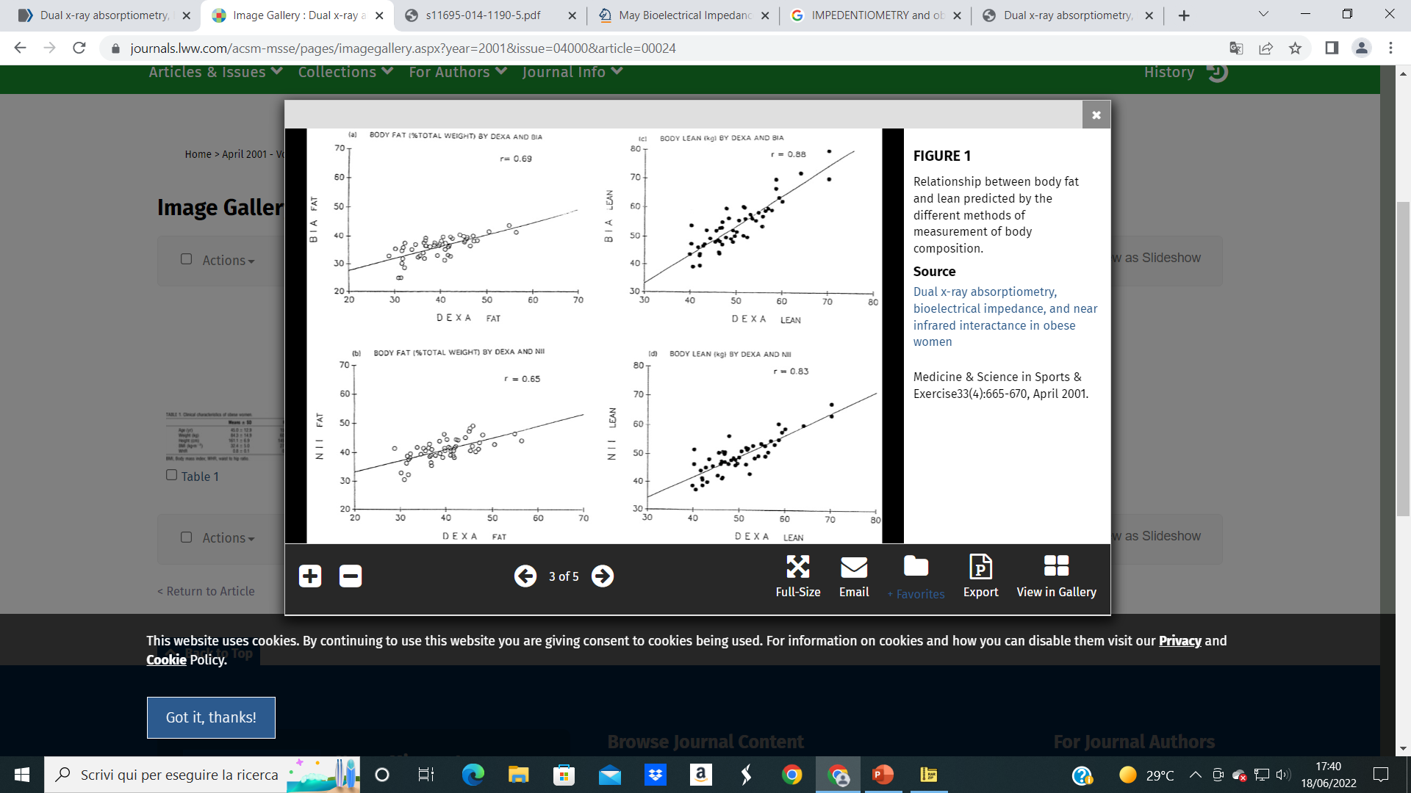
Medicine and Science in Sports and Exercise: April 2001 - Volume 33 - Issue 4 - p 665-670
Comparative study
To compare the data obtained by BIA and DXA methods of assessment of FFM and FM
53 women with obesity
Main Findings
%FM assessed by DEXA was significantly higher than that assessed by BIA (39.7 ± 6.2 vs 36.0 ± 3.8, p < 0.0001) whereas compared with DEXA, BIA gave higher values of FFM (53.7 ± 8.1 vs 50.1 ± 7.1, p < 0.0001)
The correlation coefficients for %FM and %FFM between DEXA and BIA were 0.69 and 0.88, respectively (p < 0.001).

Slide 13
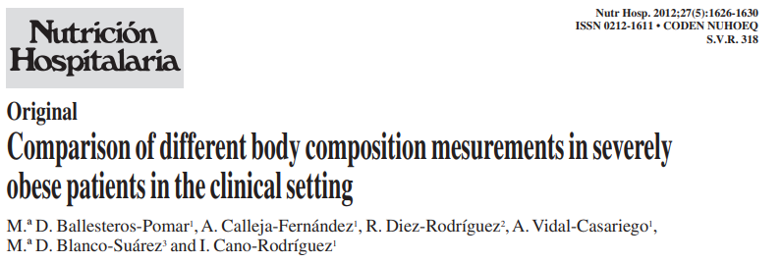
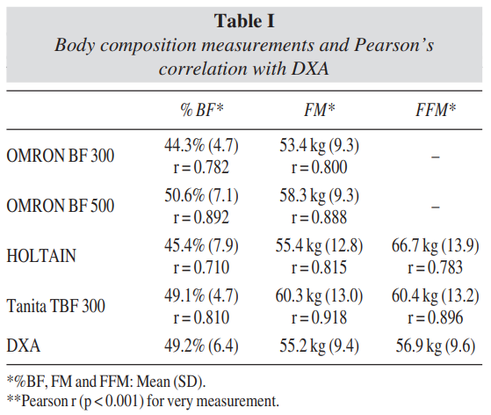
Cross-sectional study
40 severely obese patients
Main Findings
BIA measurements of FM and FFM were significantly correlated with DXA

Slide 14

TAKE HOME MESSAGE
Although not appropriate for use as a clinical parameter, BMI remains a universally accepted measure of obesity at the individual level.
BMI it is not a clinical informations and cannot be used for clinical diagnosis
Other anthropometric measures, such as waist circumference, waist-to-hip ratio, and weight-to-height ratio have been suggested as alternative methods to BMI for diagnosis of obesity. However, these anthropometric measures also have notable limitations.
BIA and DXA methods cannot be considered interchangeable
Further research are needed to develop new BIA specific equations especially formulated for patients with obesity
However, BIA can be considered, accepting the systematic error associated with the measurements, a simple, safe, non-invasive, and low-cost method for FM and FFM assessment in clinical practice and research studies in the setting of obesity BUT…………………………
The used instruments must use latest multi-frequency technology and must follow the requirements of the Directive 90/384/EEC for weighing with non-automatic devices in the medical sector and the Directive 93/42/EEC for medical devices.
BIA vs DEXA in patients with obesity

Slide 15


